Slide 1
FREELANCE WORK TRACKING SYSTEM GROUP MEMBERS: 2022F-BCE-01 2022F-BCE-09 2022F-BCE-29 2022F-BCE-45

Slide 2
Introduction:
The Freelance Work Tracking System is a web-based application designed to help freelancers manage their projects efficiently. The system allows users to track projects, monitor deadlines, analyze revenues, and visualize platform usage and task statuses. Built using Flask (Python), SQLite, HTML, and CSS, this platform offers a user-friendly interface and robust backend functionalities to improve workflow and project management for freelancers.

Slide 3

Objectives
Intuitive Platform:
Designed for easy use, the system empowers freelancers to effortlessly manage their projects.
Comprehensive CRUD Operations
The system allows users to create, read, update, and delete tasks, enabling seamless project management.
Data-Driven Insights
Dynamic charts and graphs provide valuable insights into project revenue, deadlines, and platform usage.

Slide 4
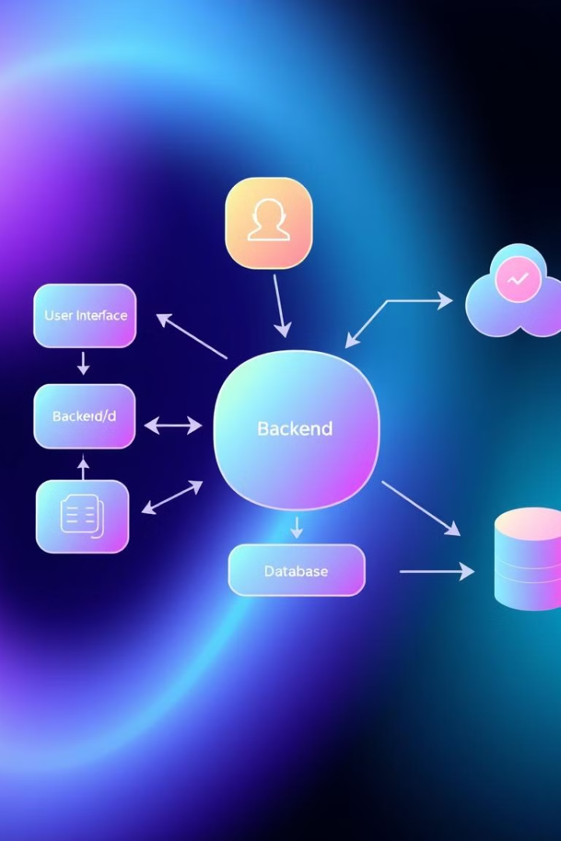



Software used:
HTML & CSS:
Used for designing and styling the front-end of the web application, creating a user-friendly and responsive interface.
SQLITE:
A lightweight database system used for storing project details, user credentials, and other essential data.
PYTHON (FLASK):
A lightweight web framework used for building the backend of the application, enabling user authentication, session management, and CRUD operations.

Slide 5
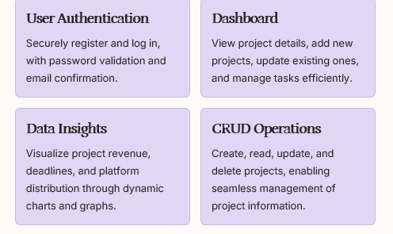
Key Features: Empowering Freelancers

Slide 6
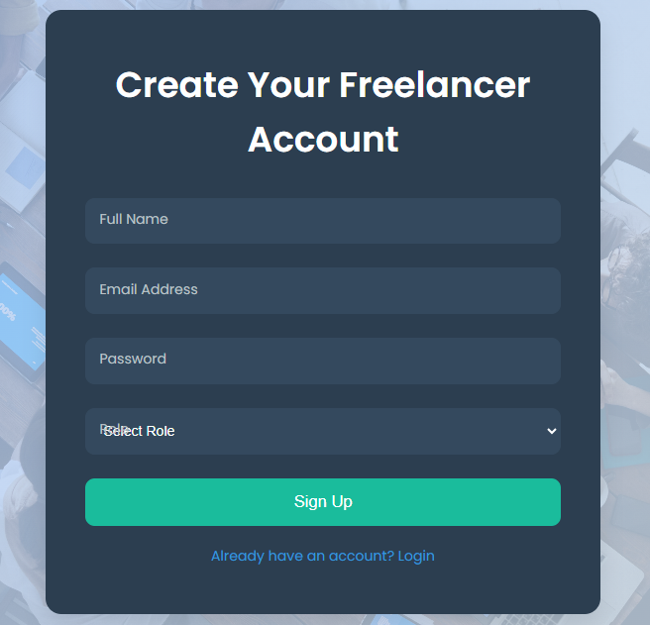
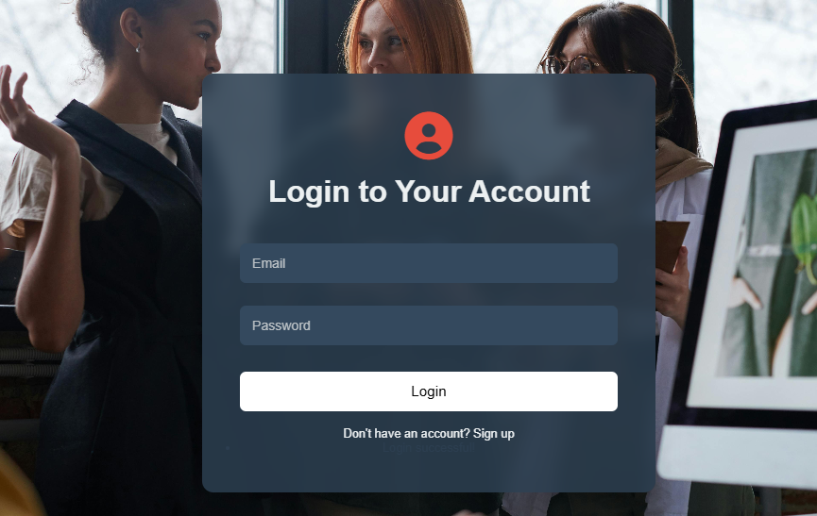
USER AUTHENTICATION:
Signup (Registration):
It is the process
where a user creates an account by providing
personal information such as username, email,
and password. The system stores this information
(usually in a secure database) to identify the user in future
sessions.
Login:
It is the process where a user provides credentials
(typically a username/email and password) to verify their
dentity and gain access to their account.

Slide 7
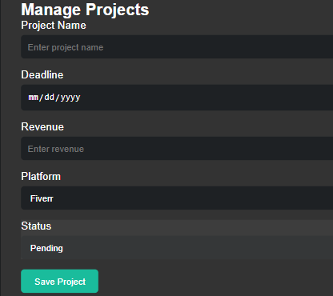
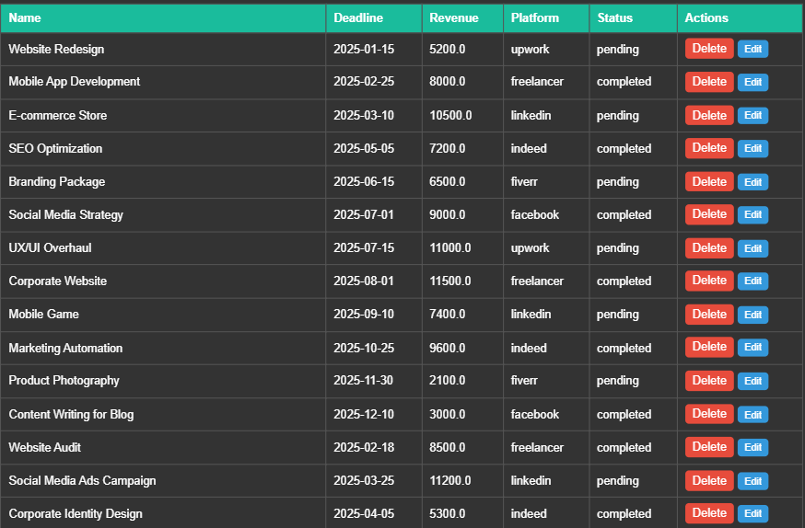
dashboard:
Project Overview:
Displays all user projects with details like project name, deadline, revenue, platform, and status.
CRUD Operations:
Allows users to add, update, and delete projects directly from the dashboard.
User-Specific Data:
Only shows projects related to the logged-in user for a personalized experience.

Slide 8
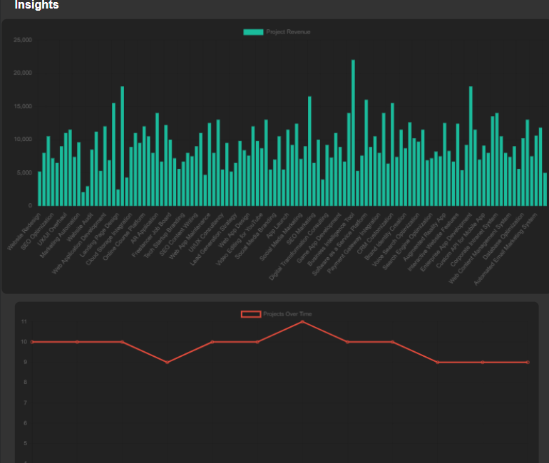
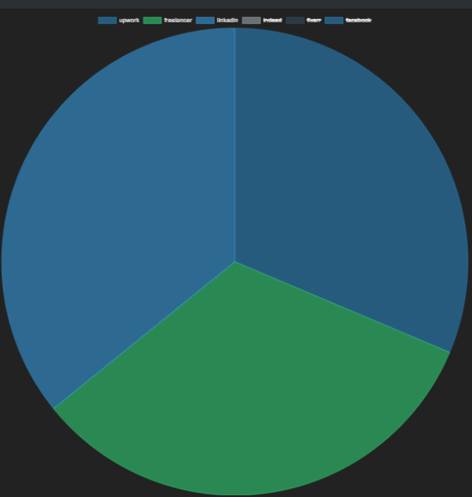
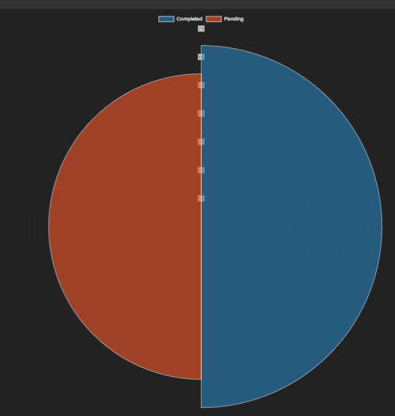
Data insights
Revenue Tracking:
Displays the total revenue from the user’s projects, helping track financial progress.
Platform Usage:
Shows how many projects are associated with different freelance platforms (e.g., Upwork, Fiverr).
Project Status:
Visualizes the distribution of projects based on their status (e.g., Completed, Ongoing).
.

Slide 9

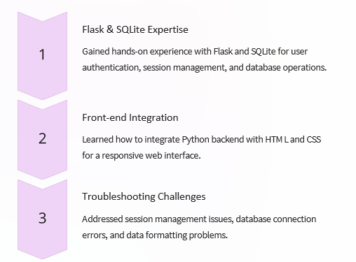
NEW LEARNINGS

Slide 10
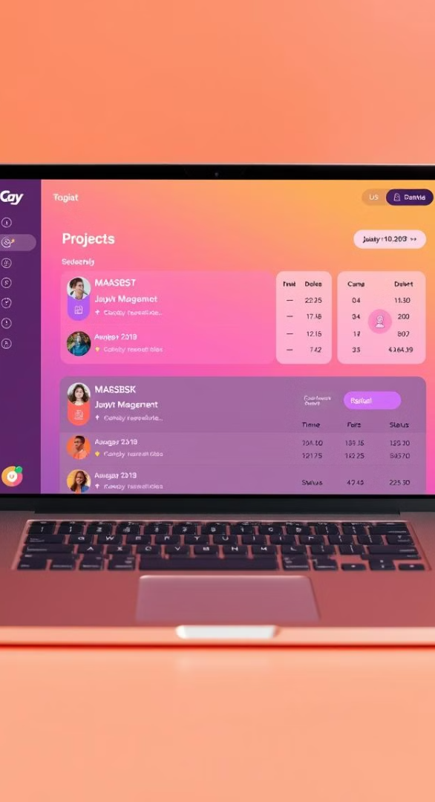
CONCLUSION :
The Freelance Work Tracking System provides a comprehensive and efficient tool for freelancers, empowering them to manage projects, track progress, and gain valuable insights. Through its user-friendly interface, robust backend functionalities, and data-driven visualizations, the system enhances workflow and decision-making, ultimately contributing to increased productivity and success.

Slide 11
Thank you

